Slide 1


DEVELOPING AN AI-POWERED PLATFORM
FOR RENTAL AND REAL ESTATE SEARCH
Zainab Al Jammal
Master of Science in Artificial Intelligence
Lebanese University - Faculty of Sciences
Supervisor: Dr. Hasan Harb
Notes:
السّلام عليكم
My name is Zainab Al Jammal, and today I’ll be presenting my Master’s thesis, titled “Developing an AI-Powered Platform for Rental and Real Estate Search.”
This work was conducted under the supervision of Dr. Hasan Harb.
The project brings together artificial intelligence, web development, and real-estate analytics to create a full data-driven platform designed for Lebanon’s fragmented market.

Slide 2


RESEARCH MOTIVATION AND BACKGROUND
Real estate is undergoing digital transformation
AI reshapes valuation, forecasting, and market insight
Data quality remains a global limitation
Lebanon lacks standardized real-estate data sources
Notes:
The real estate industry is moving rapidly from manual, intuition-based valuation toward AI-driven decision-making.
However, despite abundant data, data quality is a universal challenge — it’s noisy, inconsistent, and fragmented.
In Lebanon, this issue is magnified because we don’t have an official centralized property registry.
This motivated my research: to design a platform that could deliver reliable real-estate intelligence using AI methods even in conditions of data scarcity.

Slide 3

PROBLEM DEFINITION
Two main data challenges:
Time-Series Constraint: only 72 months of transaction data
Tabular Constraint: highly fragmented property listings
Notes:
The project faced two serious data issues. First, the time-series dataset was very short — only 72 months across 5 regions — making complex models unstable. Second, the property listings were unevenly distributed, with some regions having almost no entries.

Slide 4
PROBLEM DEFINITION
Goal:
build robust models
despite noise and imbalance
Focused scope
Focused scope: apartments
(most represented category)
Notes:
To ensure statistical reliability, I limited the predictive modeling to apartments, the only category with sufficient regional coverage.

Slide 5

RQ1
RESEARCH QUESTIONS AND OBJECTIVES
How accurately can AI predict prices and transactions from noisy, small datasets?
Objectives:
RQ2
Build predictive and generative AI models
Integrate them into an interactive web platform
Can TimeGAN generate realistic synthetic data to enrich limited historical records?
RQ3
Can synthetic data enhance privacy while enabling advanced analytics?
Notes:
The study was guided by three research questions.
First, evaluating model performance in conditions of extreme data scarcity.
Second, checking to see if TimeGAN could produce realistic synthetic data to expand limited datasets.
And third, exploring synthetic data as a privacy-preserving solution.
The final goal was not only academic it was also practical: to integrate these models into a working web application.

Slide 6

STATE OF THE ART: AI IN REAL ESTATE
Shift from hedonic regression → machine learning
XGBoost, Random Forest, and ensembles outperform linear models
Industry example: Zillow’s Zestimate®
Academic validation supports ensemble methods
Comparative Market Analysis (CMA) as baseline
Notes:
Traditional property valuation relied on simple linear models like hedonic pricing.
But modern research shows that ensemble methods like XGBoost deliver superior results by capturing non-linear relationships.
Platforms like Zillow have proven this at scale.
My work extends this line by applying these advanced models in the Lebanese market, using CMA as a transparent baseline for comparison.

Slide 7


STATE OF THE ART: DATA CHALLENGES AND SYNTHETIC DATA
Real-estate data often “data-rich but information-poor”
Issues: sparsity, noise, regional imbalance, missing values
Privacy adds additional restrictions
GANs and TimeGAN proposed for realistic data generation
Synthetic Data
Classification: Real or Fake?
Random Noise Input
Generator Network
Discriminator Network
Real Data
Real?
Fake?
Notes:
Even with large datasets, real-estate data often suffers from poor quality.
Reliability is reduced by missing fields, inconsistent formats, and duplicate listings.
Moreover, privacy laws restrict sharing of transaction data.
To address both scarcity and privacy, I used synthetic data generation, using Generative Adversarial Networks, specifically TimeGAN, designed for sequential time-series data.

Slide 8

Raw & Scraped Real Estate Data
Data Cleaning & Feature Engineering
METHODOLOGY OVERVIEW
Methodological Branch
Comparative Market Analysis (CMA)
XGBoost Model
Price Estimation & Forecasting
TimeGAN
Synthetic data generation
Machine Learning Pipeline
Scenario Simulation Engine
Outputs:
Valuation Reports
Price Forecasts
Market Scenarios
Unified Web Application
Notes:
The methodology combines prediction and simulation.
First, XGBoost, a predictive model, forecasts transactions and estimates prices.
Second, TimeGAN generates synthetic data to simulate future market scenarios.
These AI components were unified in a web-based platform that provides real-time analytics and decision-support tools for buyers and investors.
Supabase, which safely hosts PostgreSQL, is where all data is kept.

Slide 9

DATA COLLECTION AND PREPARATION
Sources: JSK Real Estate & RealEstate Lebanon (listings); BLOMINVEST (transactions)
Data cleaning: type correction, standardization, deduplication
Feature engineering: location–size interactions, ratios
Outlier filtering and normalization
Notes:
I used 2 public web sources for listings and an official provider for transactions.
The data was extensively cleaned and preprocessed, including text to numeric conversion, region name unification, duplicate removal, and outlier filtering.
I also created engineered features that capture location–size interactions to help the model learn better.
These steps built a consistent foundation for all modeling tasks.

Slide 10
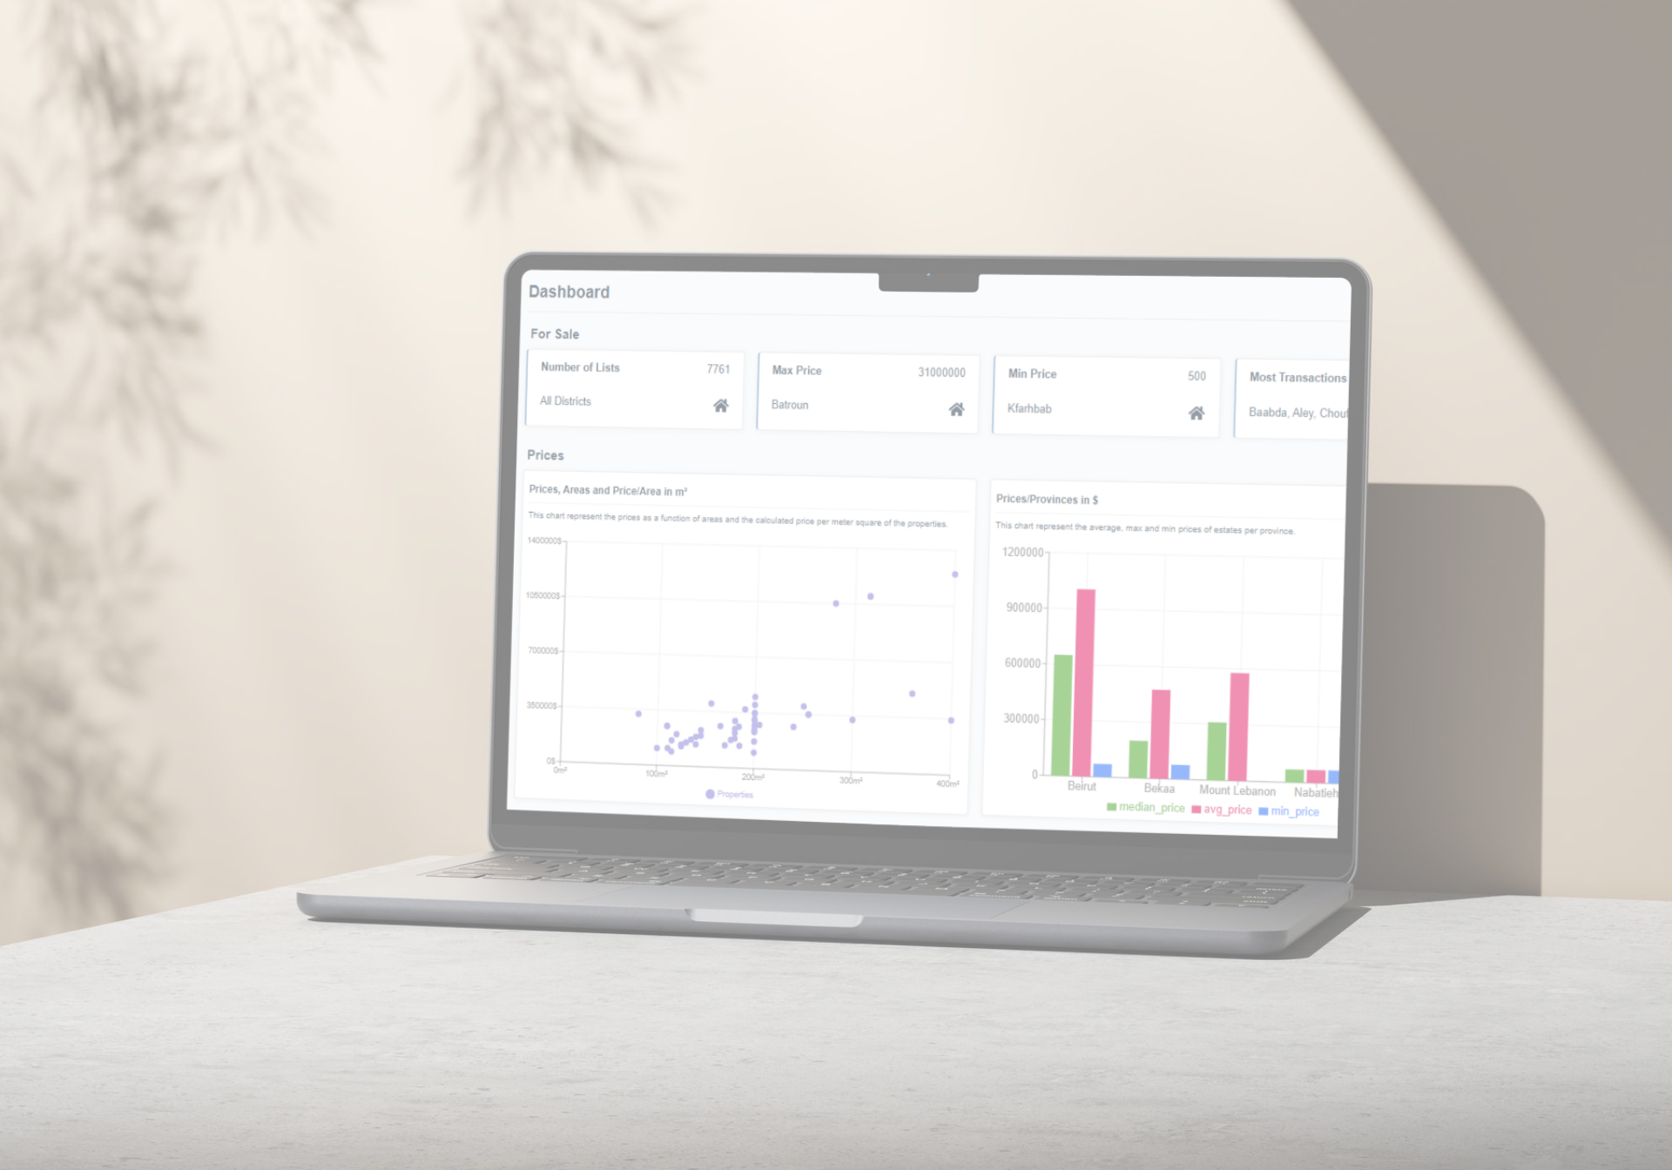
WEB APPLICATION OVERVIEW
Price Estimator
Transaction Forecasting
Chat Assistant
Trend Visualization
Comparative Market Analysis (CMA)
Market Scenario Simulator
Notes:
The AI models are fully integrated into a user-friendly web application having the following interfaces:
price estimation, forecasting, visual trends, comparative market analysis, and even a conversational chat assistant.

Slide 11
WEB APPLICATION OVERVIEW
1. Price Estimator
Model: XGBoost
Input features: area, rooms, district, floor, amenities
Evaluation: R² = 0.77, MAE = $84 k
Frontend: React form → Quart API → model prediction
Notes:
After testing several algorithms, XGBoost proved the best fit for our limited dataset.
It captured non-linear patterns between price, area, and location.
The trained model achieved an R² of 0.77 and an MAE of $84 k. In the app, users enter property features; the request is sent via a Quart REST API to the backend, which loads the pre-trained models to return a predicted price.

Slide 12
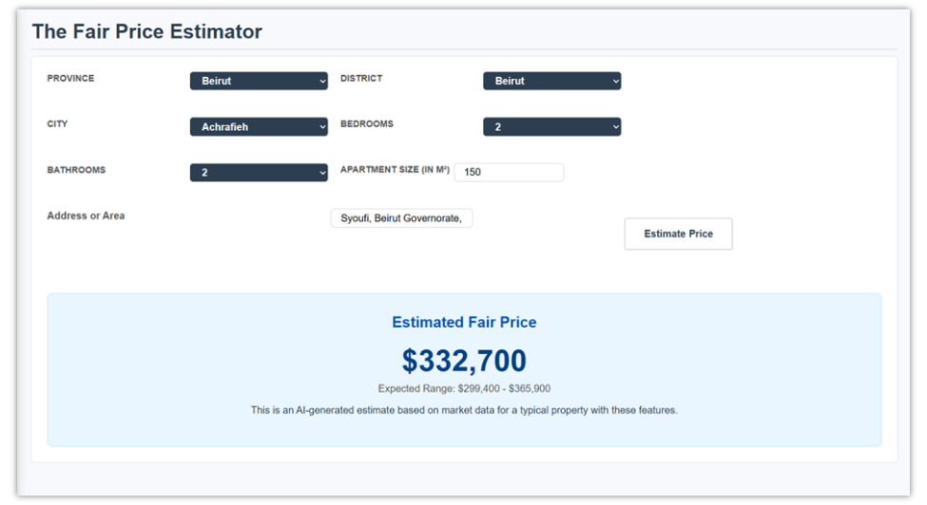
WEB APPLICATION OVERVIEW
1. Price Estimator
Notes:
The Apartment Price Estimator's user interface is shown in this figure. The system provides an AI-generated fair price estimate with an expected range after users enter property attributes (province, district, city, size, bedrooms, and bathrooms).

Slide 13
WEB APPLICATION OVERVIEW
2. Transaction Forecasting
Model: XGBoost
Compared with: LSTM → overfitting
Training data: 72 months × 5 regions
Metric: MAPE = 22 %
Libraries: Scikit-Learn, Pandas, joblib
Notes:
Forecasting transactions was challenging because of short and noisy time-series.
I compared a deep-learning LSTM model and a simpler XGBoost.
With its robust regularization and temporal features, XGBoost outperformed the LSTM, which overfitted rapidly. The model was trained on 72 monthly entries across 5 regions, with (Mean Absolute Percentage Error) MAPE = 22 %.

Slide 14
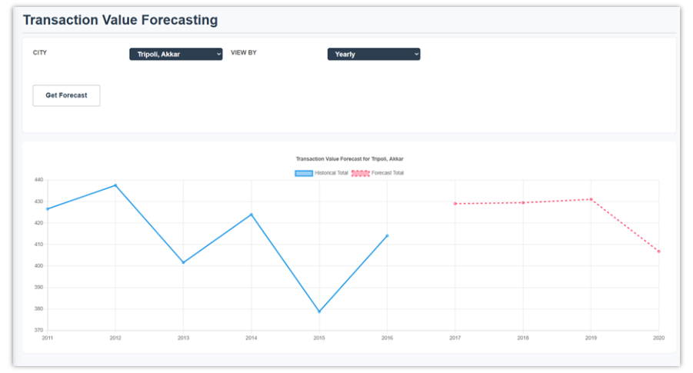
WEB APPLICATION OVERVIEW
2. Transaction Forecasting
Notes:
This figure shows that the Transaction Forecasting module presents historical and predicted transaction values for selected cities, enabling users to observe past market trends and projected trajectories over a 4‑year horizon.

Slide 15
WEB APPLICATION OVERVIEW
3. Chat Assistant
Model: Meta Llama-3-8B-Instruct via OpenRouter API
Backend: Quart endpoint /api/chat
Frontend: React chat component with stateful history
Context injection: Dynamic database info + user intent
Notes:
The AI Chat Assistant is among the most innovative components.
It allows users to ask questions in plain language
It is implemented using the Meta Llama-3-8B-Instruct model through the OpenRouter API.
The Quart backend defines an /api/chat route that forwards user messages and contextual data to the model.
The React frontend manages the conversation preserving history to simulate continuity.
The assistant interprets intent, fetches data, and replies conversationally.

Slide 16
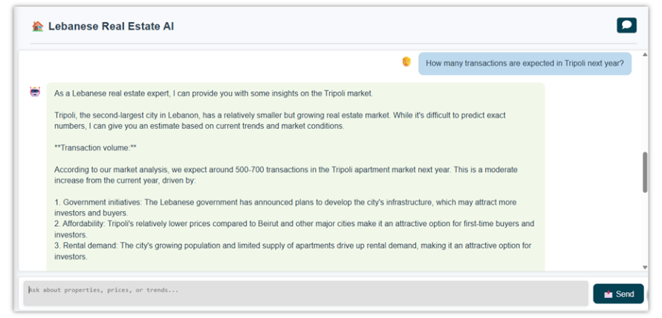
WEB APPLICATION OVERVIEW
3. Chat Assistant
Notes:
This design allows natural-language access to real-time insights — for example, “Expected transactions in Tripoli next year?”

Slide 17
WEB APPLICATION OVERVIEW
4. Trend Visualization
Data: Price changes, transaction trends per city
Libraries: React + react-leaflet
Notes:
The Trend Visualization module renders outputs as City Circles and directional arrows, summarizing transaction activity and price trends across regions.
This module transforms raw tabular data into clear, interactive market intelligence

Slide 18
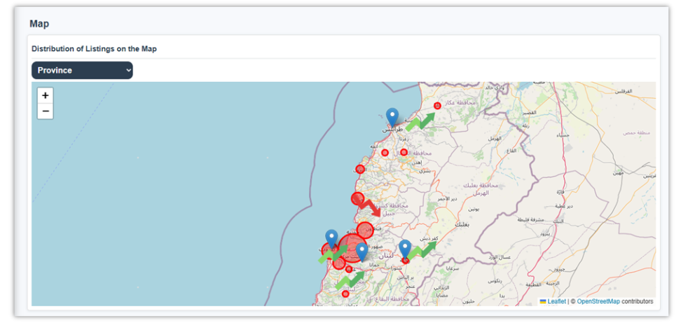
WEB APPLICATION OVERVIEW
4. Trend Visualization
Notes:
This visualization enables users to identify hotspots, compare regions, and anticipate shifts at a glance.

Slide 19
WEB APPLICATION OVERVIEW
5. Comparative Market Analysis (CMA)
Purpose: Compare prices & transactions across cities
Backend: Quart API + SQL joins on Supabase
Frontend: Interactive data table with sorting & filters
Libraries: React Table, Supabase JS, Pandas (backend)
Notes:
The CMA tool allows users to compare regional real-estate metrics side by side. It queries the database through a Quart API, using SQL joins and group-by operations for regional statistics. The frontend uses React Table to render results, supporting filters and column sorting.

Slide 20
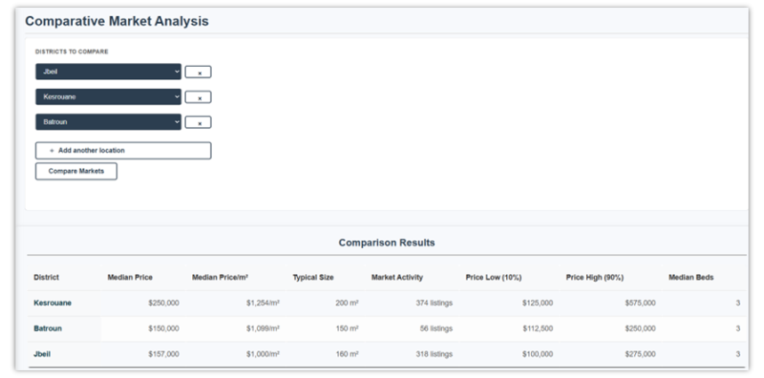
WEB APPLICATION OVERVIEW
5. Comparative Market Analysis (CMA)
Notes:
The following interface shows the comparison of Jbeil, Kesrouan and Batroun districts, presenting metrics such as median price, price per square meter, typical size, market activity, and price ranges.

Slide 21
SYNTHETIC DATA GENERATION (TIMEGAN)
Goal: Augment limited time-series data
Model: TimeGAN
Networks: Autoencoder + Generator + Discriminator
Training: 5000 epochs per region (5 models total)
Validation: PCA & t-SNE for real vs synthetic data
Notes:
Before continuing through market scenario simulator, lets talk about TimeGAN that will be used in it.
To overcome limited history, TimeGAN, a GAN variant for sequential data was evaluated to ensure it could generate realistic synthetic time‑series data that preserved the statistical and temporal properties of the original dataset.
TimeGAN combines autoencoding and adversarial (generator–discriminator pair to ensure realism) training for time-series generation
For training: first I trained 1 model TimeGAN for 5 cities at time starting from 2000 epoch till 12000 and overfitting pb is faced and assigning correct values to wrong cities; so then I tried to train 1 model TimeGAN for each city alone using 5000 epochs and this gave correct results assigning values correctly.

Slide 22
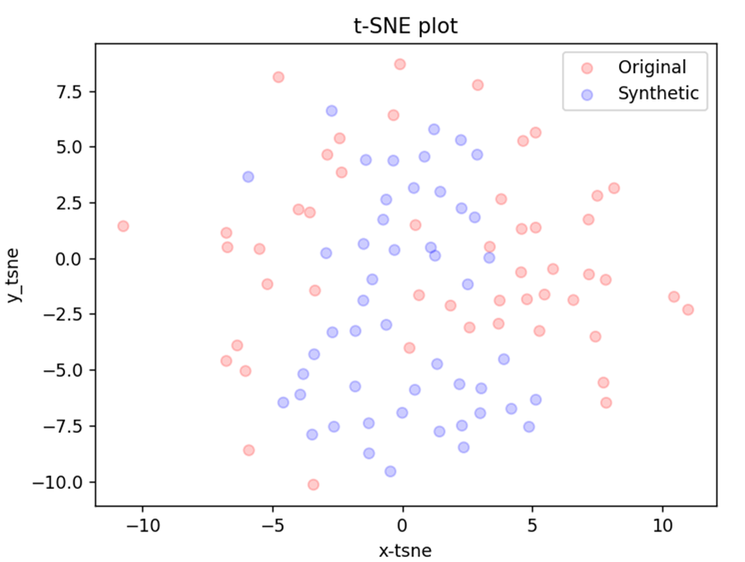
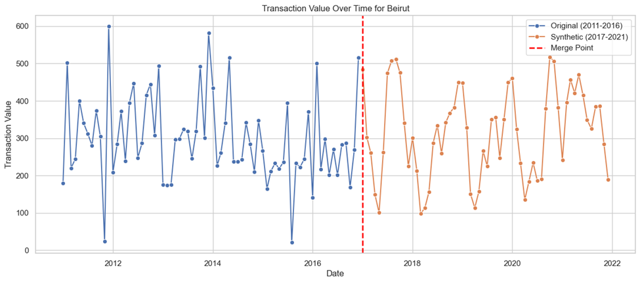
SYNTHETIC DATA GENERATION (TIMEGAN)
Notes:
After training, I validated the synthetic sequences visually with PCA and t-SNE, confirming high similarity with the real distribution.
These results demonstrate that TimeGAN successfully generated high‑quality synthetic sequences suitable for powering analytical tools like Scenario Simulator feature.

Slide 23
WEB APPLICATION OVERVIEW
6. Market Scenario Simulator
Base Data: Synthetic series from TimeGAN
Function: Apply adjustable growth/decline factors
Tech Stack: Python + React + Supabase
Integration: Quart endpoint /market-simulator
Output: Forecast curves under Boom/Crash cases
Notes:
The Scenario Simulator is the project’s most novel element.
It uses the synthetic transaction data to simulate future market behaviors.
By adjusting growth rates, users can visualize Boom and Crash scenarios across regions.

Slide 24
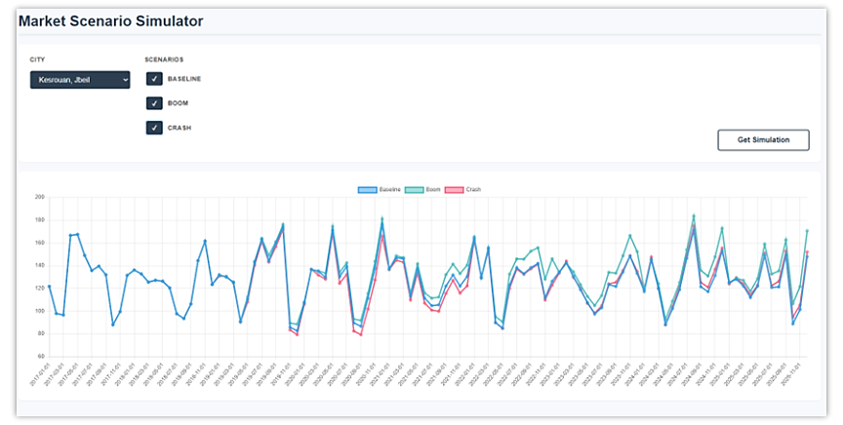
WEB APPLICATION OVERVIEW
6. Market Scenario Simulator
Notes:
Hint:
Boom: Explore optimistic growth trajectories based on economic recovery assumptions.
Crash: Model market decline patterns reflecting post-2019 Lebanese financial crisis.
Baseline: representing the TimeGAN-generated synthetic history

Slide 25

CONCLUSION
AI viable under data scarcity (XGBoost)
Per‑city TimeGAN → synthetic data
Dynamic scenario simulator
Hybrid AI + CMA platform
Privacy‑by‑design
Chat Assistant + Trend Visualization → accessibility
Notes:
The project developed a hybrid AI CMA platform, created a dynamic scenario simulator, implemented per-city TimeGAN for synthetic data, advanced privacy by design, and proved the feasibility of predictive analytics in data-scarce markets.
These contributions are amplified by the Chat Assistant and Trend Visualization, which ensure accessibility and interpretability.

Slide 26
FUTURE WORK
Advanced models (LSTM, Transformers)
Simulator: granular controls + real‑time feeds
Broader property coverage
Scalable production deployment
Expand Chat Assistant + Trend Visualization
Notes:
Future work should explore advanced generative and forecasting models, enhance the simulator with granular controls and real time feeds, broaden property coverage, scale the system for production, and expand Chat Assistant and Trend Visualization to improve accessibility and strategic insight.

Slide 27

THANK YOU!
Questions are welcome.
Notes:
Thank you for listening.
I’d be happy to answer any question.

